Slide 1

Machine Learning Intro in 30 60 minutes
Athanasios Lagopoulos lathanag@csd.auth.gr
ACM AUTH Student Chapter

Slide 2


01 - Intro
What is machine learning, where is it used, types of machine learning
02 – Our Approach today
What is this workshop about
Table of Contents
03 – Lets HAVE SOME FUN
Get your hands dirty with python and machine learning
04 – Questions & DISCUSSION
Your questions and further discussion

Slide 3
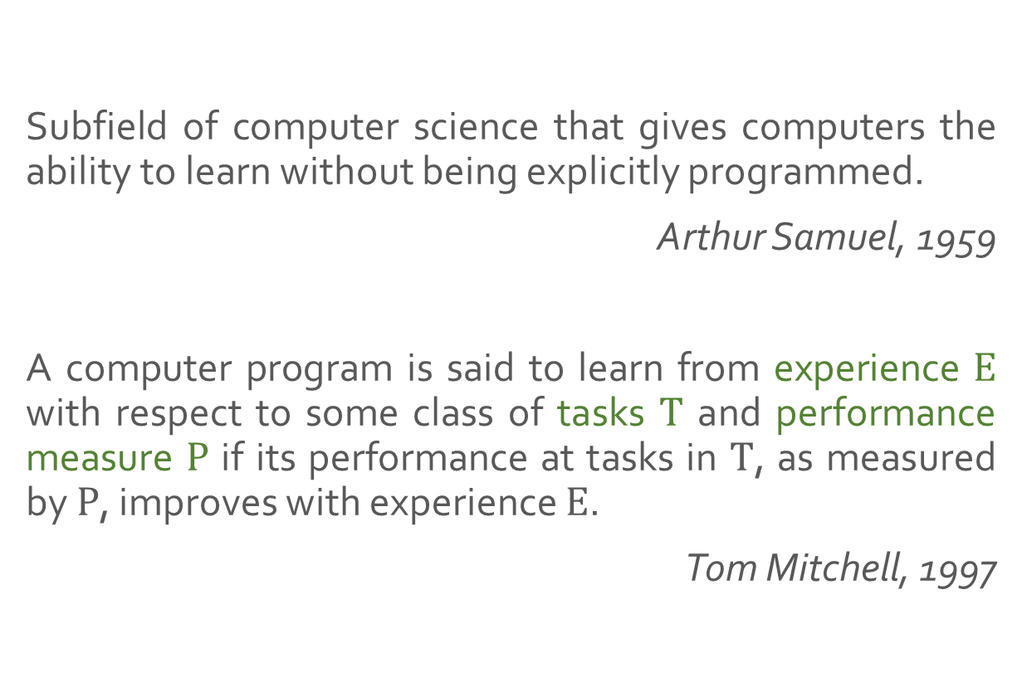
Machine Learning
Subfield of computer science that gives computers the ability to learn without being explicitly programmed.
Arthur Samuel, 1959
A computer program is said to learn from experience $E$ with respect to some class of tasks $T$ and performance measure $P$ if its performance at tasks in $T$, as measured by $P$, improves with experience $E$.
Tom Mitchell, 1997

Slide 4








Applications
Analytics
Healthcare
Natural Language Process
Security
Finance
Image Recognition
Automotive
Recommendations
…soon everywhere
Notes:
Automotive, manufacturing, consumer, finance, agriculture, energy, healthcare, media, transportation, mention price prediction

Slide 5
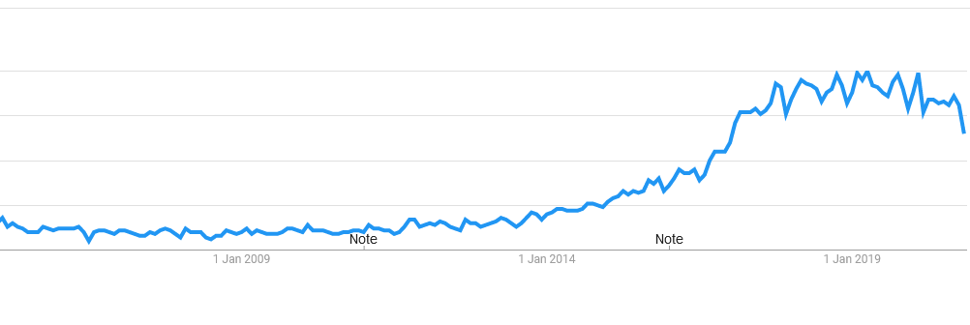
Google Trends: Machine Learning (2004 – Today)

Slide 6
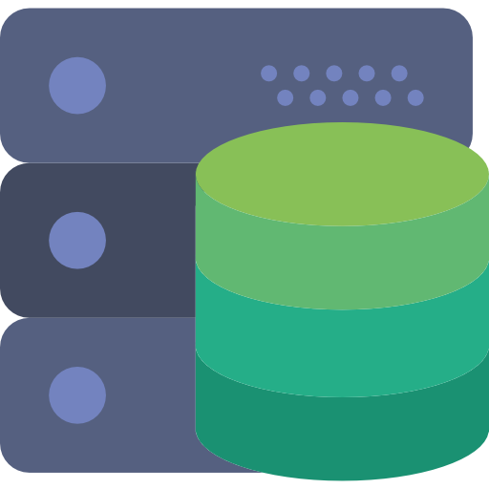

Why now?
Data Growth
Computing Power

Slide 7



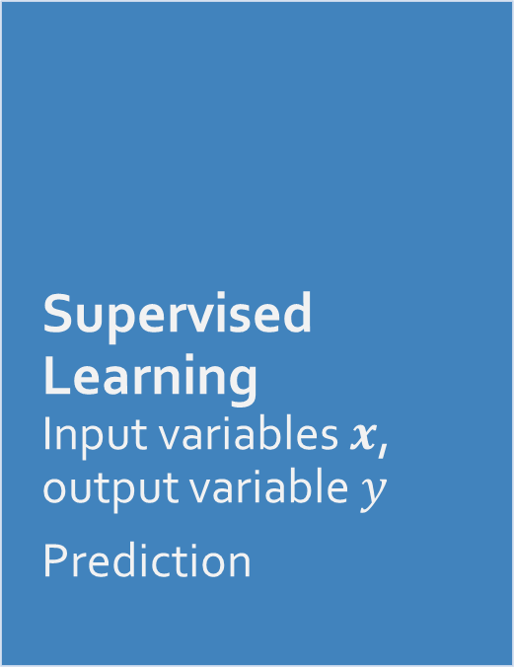
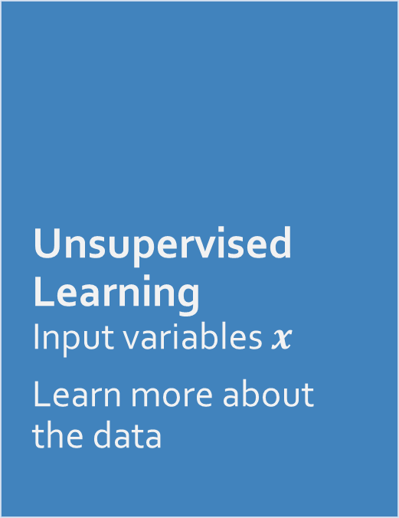
Main types of Machine Learning
Supervised Learning Input variables $x$, output variable $y$
Prediction
Unsupervised Learning Input variables $x$
Learn more about the data
Reinforcement Learning Agent acting in an environment so as to get a reward
Notes:
Give classification (client loan)/regression (house price) examples, main/mature category, easier to find value in industry, aka function approximation, induction to go beyond what you see
2. Clustering/dimensionality reduction for visualization examples, in support of supervised learning
Semi-supervised learning, Active learning, Transductive learning
3. Learning in living organisms, AlphaGo, AlphaStar(Craft), Robots

Slide 8

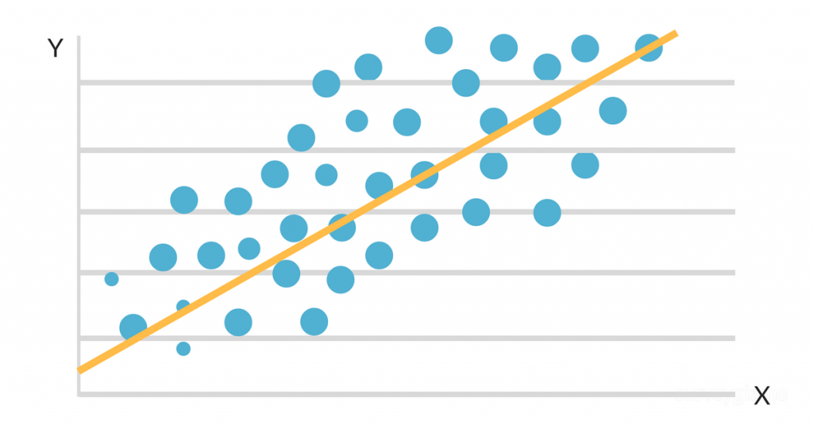
Supervised Learning
Classification Discrete or categorical output variables
Regression Numerical or continuous output variables

Slide 9
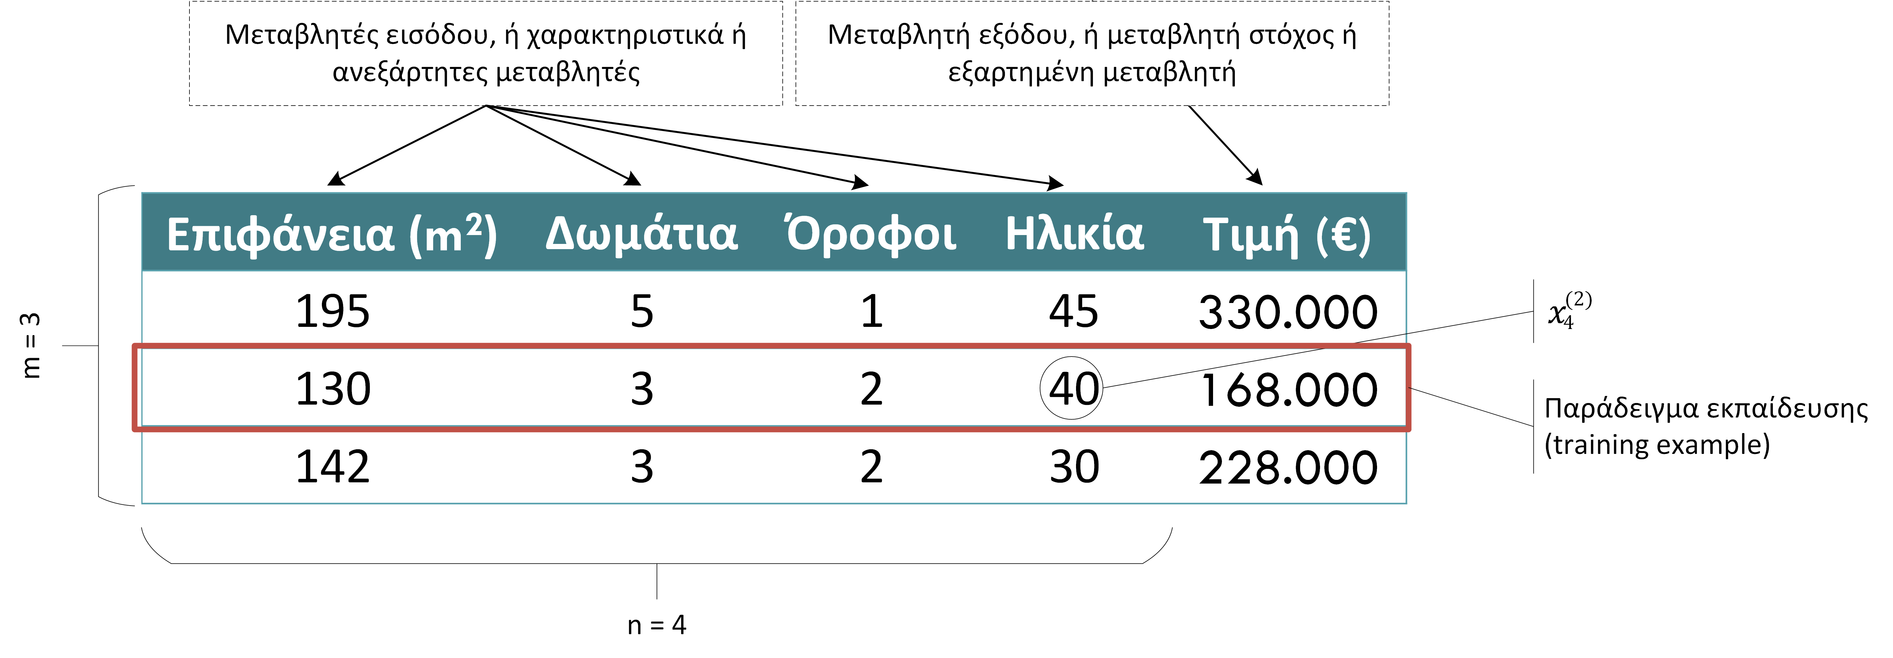
Notation

Slide 10
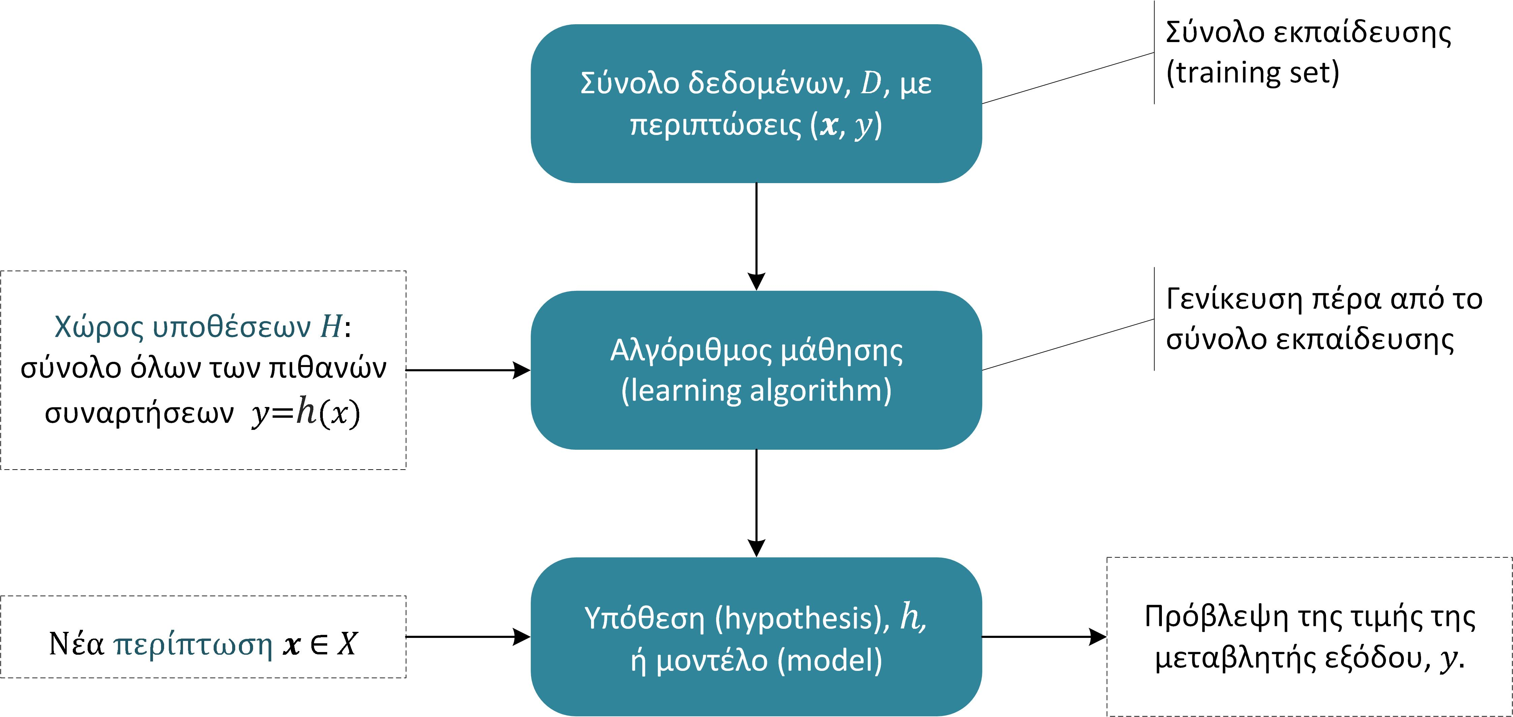
Learning Process

Slide 11

Our approach today
An end to end example
Simple and real
Python – Google Colab – No Setup
Regression Problem
More than just using an algorithm

Slide 12
Visit ->
http://bit.ly/acmml
Notes:
https://colab.research.google.com/drive/1gzbPrDrTys77ESmfPZ1-uvr_AvqKWKLT

Slide 13
Questions?
Let’s discuss!

Slide 14
Thank you!
Athanasios Lagopoulos lathanag@csd.auth.gr
ACM AUTH Student Chapter

